Slide 1
Marketing Your Travel Program Using Social Media
Annual Conference & Tradeshow
Celebrating 26 years of service to the Collegiate Travel Marketplace
Jay Campbell
Chief Social Media Strategist
Strategic Social Consulting 1-800-280-2529 x707
Jay@StrategicSocialConsulting.com

Slide 2
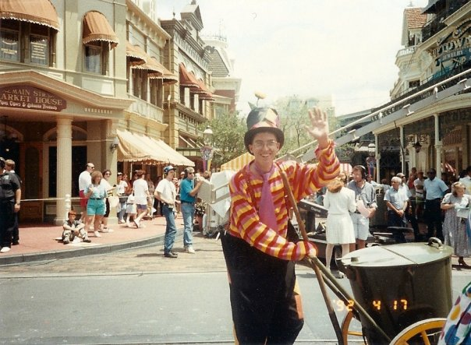
Annual Conference & Tradeshow
Celebrating 26 years of service to the Collegiate Travel Marketplace
About Jay Campbell
Strategic Consultant on Social Media
Clients include 5th largest CPA firm in the country
National Speaker on Social Media
Former Employers Include:
Walt Disney World
British Airways

Slide 3
Annual Conference & Tradeshow
Celebrating 26 years of service to the Collegiate Travel Marketplace
Agenda
A few facts about social media
Social Media Strategy
Facebook
Twitter
Video
Using Social Media to Improve Customer Service
Online Travel & Review Sites
Tools You Can Use
Topics You Should Post About
Takeaways

Slide 4
Annual Conference & Tradeshow
Celebrating 26 years of service to the Collegiate Travel Marketplace
Social Media is a Communication Tool

Slide 5
Annual Conference & Tradeshow
Celebrating 26 years of service to the Collegiate Travel Marketplace
NOT A Marketing Tool

Slide 6
Annual Conference & Tradeshow
Celebrating 26 years of service to the Collegiate Travel Marketplace
Gartner Says Social-Networking Services to Replace E-Mail as the Primary Vehicle for Interpersonal Communications for 20 Percent of Business Users by 2014

Slide 7
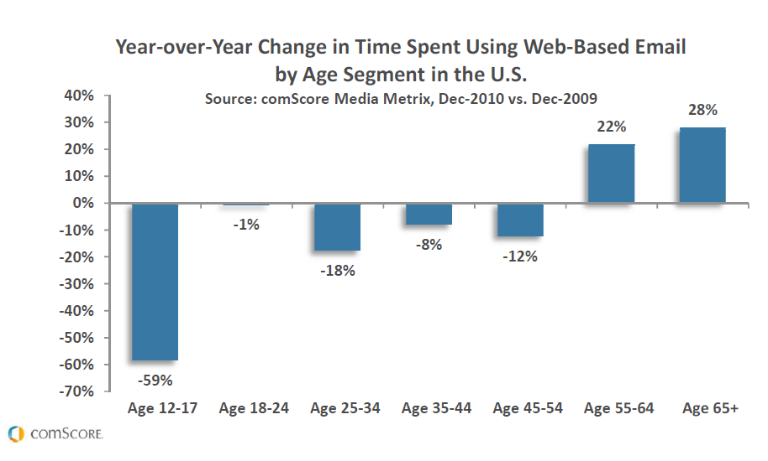
Annual Conference & Tradeshow
Celebrating 26 years of service to the Collegiate Travel Marketplace

Slide 8
Annual Conference & Tradeshow
Celebrating 26 years of service to the Collegiate Travel Marketplace
Social Media Strategy

Slide 9
Annual Conference & Tradeshow
Celebrating 26 years of service to the Collegiate Travel Marketplace
Questions to ask before creating your social media strategy:
What are our departments goals?
How much bandwidth do we have?
Who will supply the content?

Slide 10
Annual Conference & Tradeshow
Celebrating 26 years of service to the Collegiate Travel Marketplace
Questions to ask before creating your social media strategy:
Why are your colleagues not using the travel department?
Out of the people who have used your services how many come back vs. going else where.
Survey current and past customers on their perspective.

Slide 11
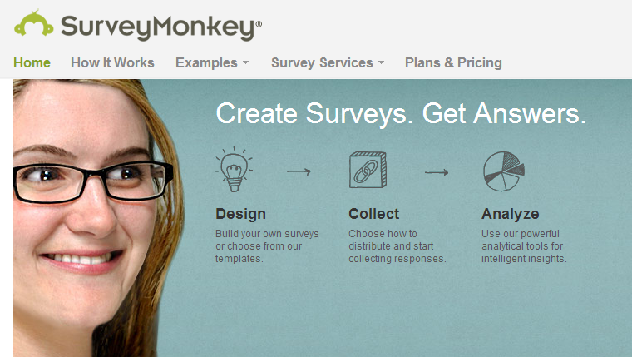
Annual Conference & Tradeshow
Celebrating 26 years of service to the Collegiate Travel Marketplace
1) Create three surveys:
a) Past clients
b) Current clients
c) Those who always
book through an
outside source
2) SurveyMonkey prices
start at just $17 per
month

Slide 12
Annual Conference & Tradeshow
Celebrating 26 years of service to the Collegiate Travel Marketplace
Facebook

Slide 13
Annual Conference & Tradeshow
Celebrating 26 years of service to the Collegiate Travel Marketplace
67% of B2C companies and 41% of B2B companies have acquired a customer from Facebook.

Slide 14
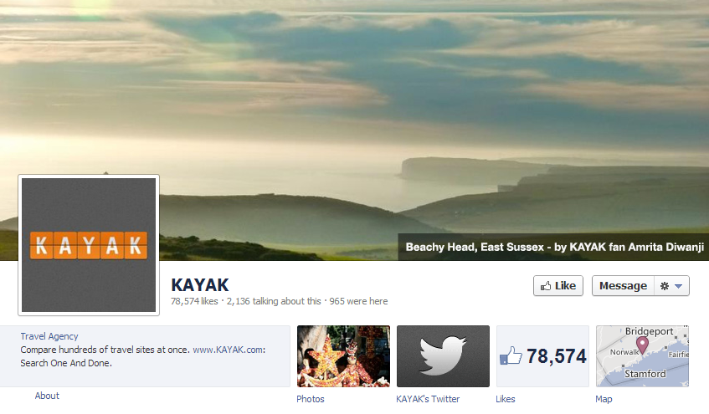
Annual Conference & Tradeshow
Celebrating 26 years of service to the Collegiate Travel Marketplace

Slide 15
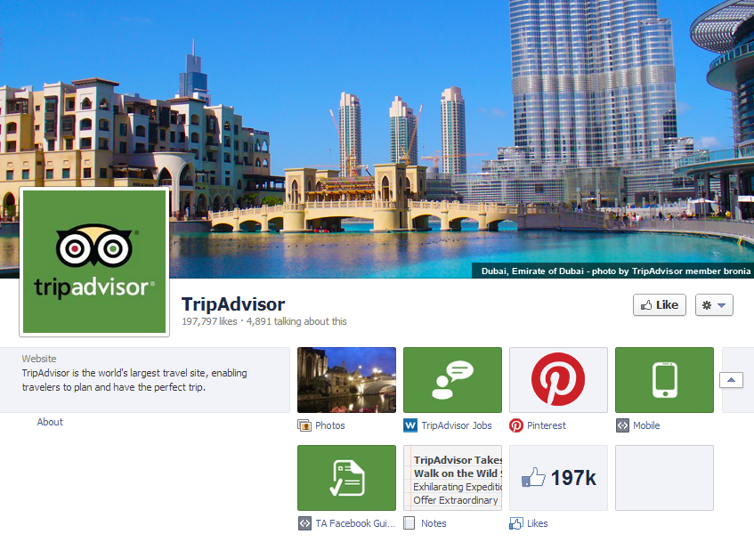
Annual Conference & Tradeshow
Celebrating 26 years of service to the Collegiate Travel Marketplace

Slide 16
Annual Conference & Tradeshow
Celebrating 26 years of service to the Collegiate Travel Marketplace

Slide 17
Annual Conference & Tradeshow
Celebrating 26 years of service to the Collegiate Travel Marketplace
How Can I Get So Many Likes?

Slide 18
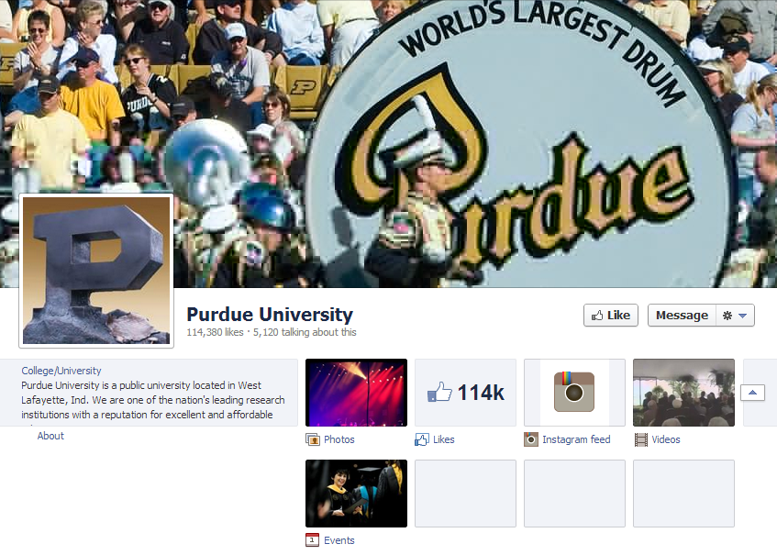
Annual Conference & Tradeshow
Celebrating 26 years of service to the Collegiate Travel Marketplace

Slide 19
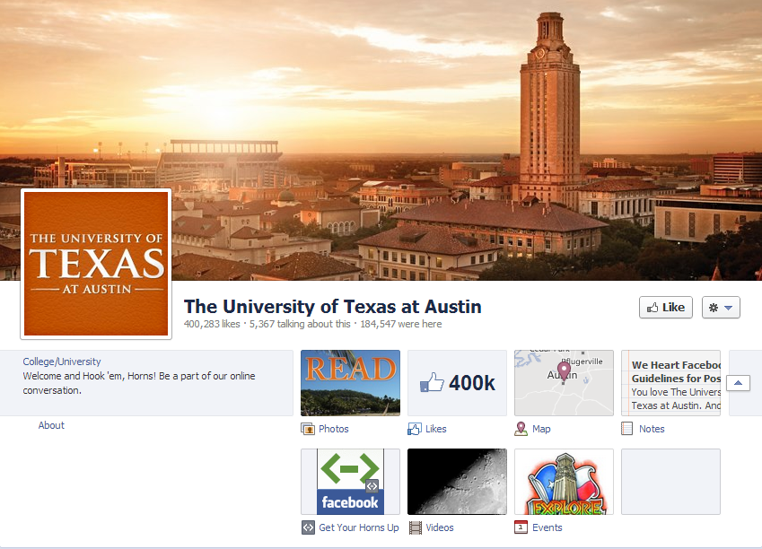
Annual Conference & Tradeshow
Celebrating 26 years of service to the Collegiate Travel Marketplace

Slide 20
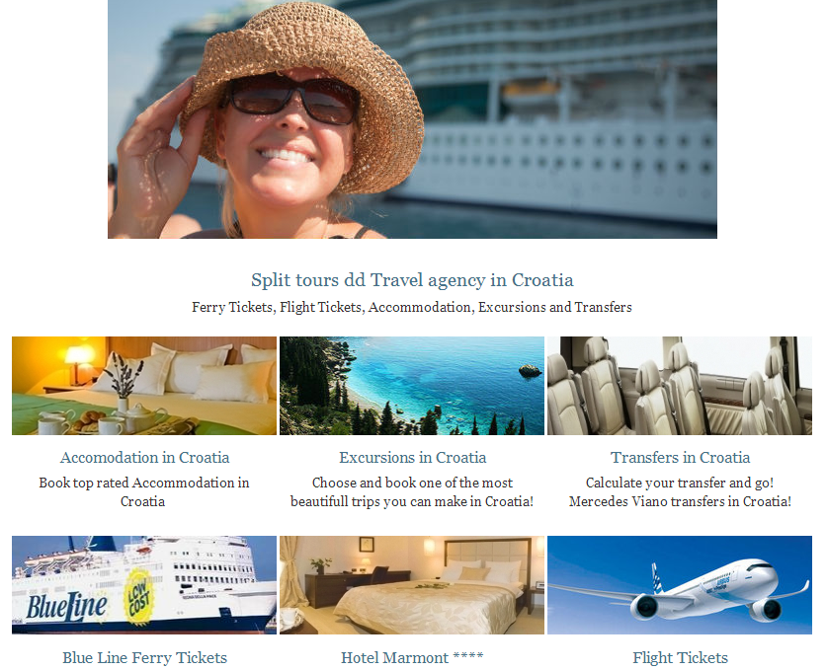
Annual Conference & Tradeshow
Celebrating 26 years of service to the Collegiate Travel Marketplace
Utilize Facebook tabs
Pagemondo.com lets you create a website looking Facebook tab
The image to the left is from Pagemondo

Slide 21
Annual Conference & Tradeshow
Celebrating 26 years of service to the Collegiate Travel Marketplace
Twitter

Slide 22
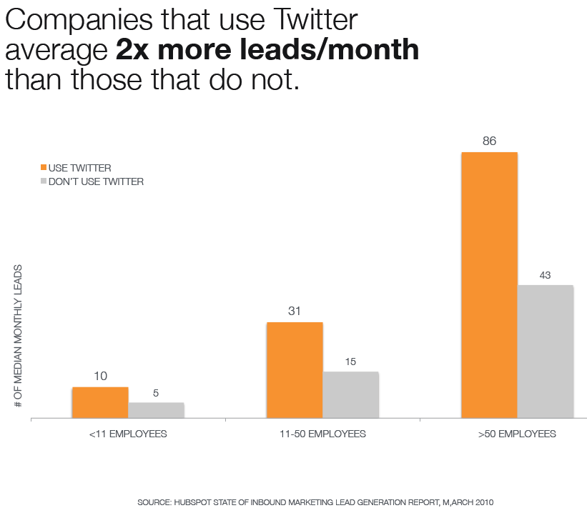
Annual Conference & Tradeshow
Celebrating 26 years of service to the Collegiate Travel Marketplace

Slide 23
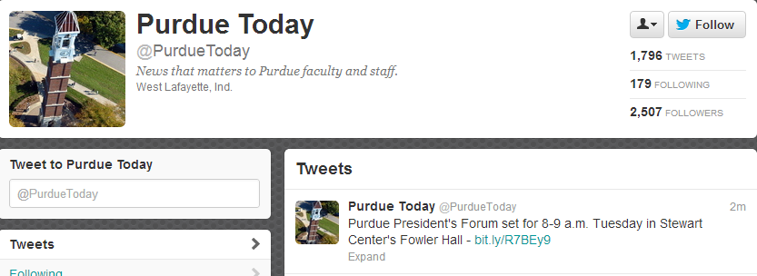
Annual Conference & Tradeshow
Celebrating 26 years of service to the Collegiate Travel Marketplace

Slide 24
Annual Conference & Tradeshow
Celebrating 26 years of service to the Collegiate Travel Marketplace

Slide 25
Annual Conference & Tradeshow
Celebrating 26 years of service to the Collegiate Travel Marketplace

Slide 26
Annual Conference & Tradeshow
Celebrating 26 years of service to the Collegiate Travel Marketplace
Video

Slide 27
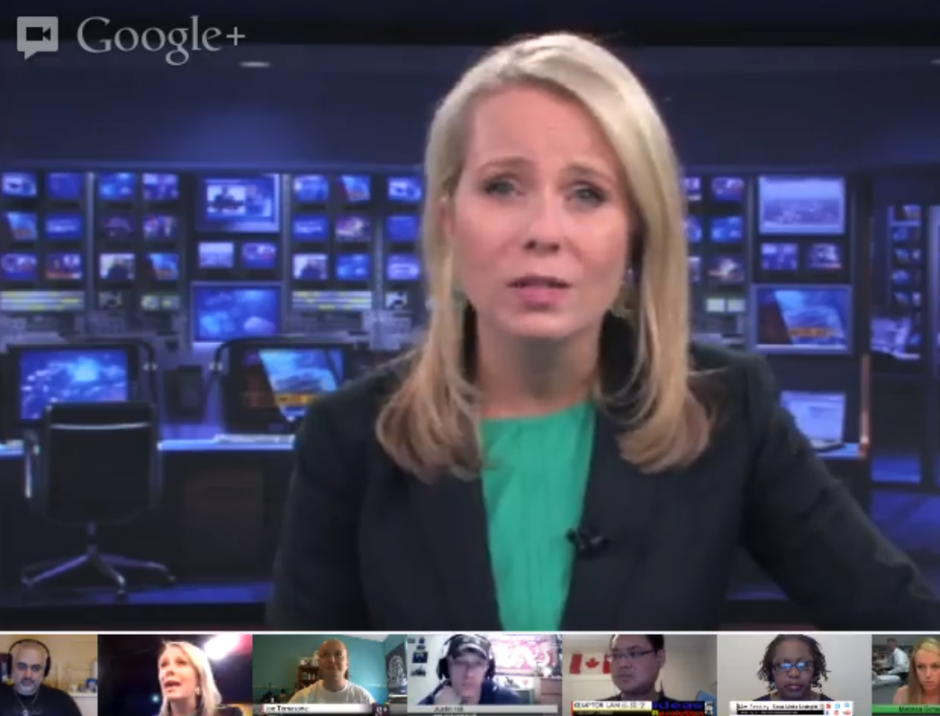
Annual Conference & Tradeshow
Celebrating 26 years of service to the Collegiate Travel Marketplace
Video is a great way to add value to your service
Google+ allows you to not only broadcast but create a live dialog
Google+ video can be streamed and stored on YouTube.

Slide 28
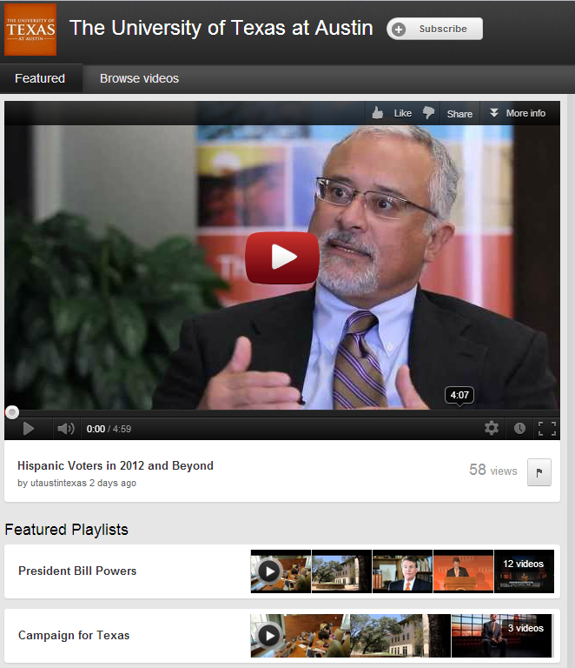
Annual Conference & Tradeshow
Celebrating 26 years of service to the Collegiate Travel Marketplace
YouTube is the 2nd most popular B2B website
Typically videos should run for under 2 minutes
Create Playlists to organize your video’s

Slide 29
Annual Conference & Tradeshow
Celebrating 26 years of service to the Collegiate Travel Marketplace
Using Social Media to Improve Customer Service

Slide 30
Annual Conference & Tradeshow
Celebrating 26 years of service to the Collegiate Travel Marketplace
How do your clients find out about canceled flights?
Is there anyone they can call?
How would your client react to being stranded?

Slide 31
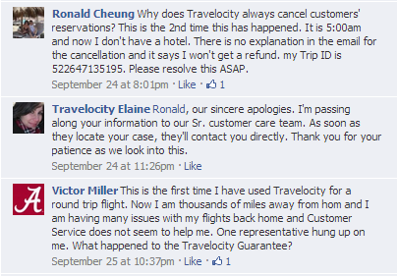
Annual Conference & Tradeshow
Celebrating 26 years of service to the Collegiate Travel Marketplace
Does this happen with your agency?
What if your client was in another country is there someone they can call for help?

Slide 32
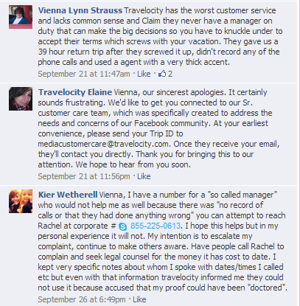
Annual Conference & Tradeshow
Celebrating 26 years of service to the Collegiate Travel Marketplace
How is your customer service?
Do you have an escalation path?
How long does it take your university to resolve an issue?

Slide 33
Annual Conference & Tradeshow
Celebrating 26 years of service to the Collegiate Travel Marketplace
Online Travel & Review Sites

Slide 34
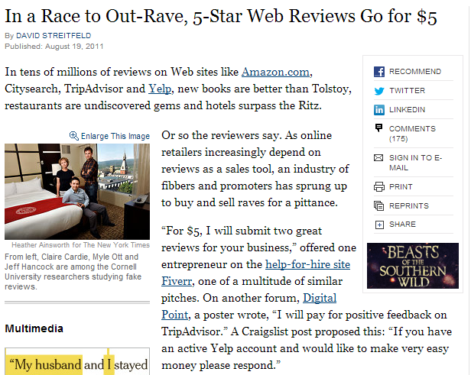
Annual Conference & Tradeshow
Celebrating 26 years of service to the Collegiate Travel Marketplace

Slide 35
Annual Conference & Tradeshow
Celebrating 26 years of service to the Collegiate Travel Marketplace

Slide 36
Annual Conference & Tradeshow
Celebrating 26 years of service to the Collegiate Travel Marketplace
Tools You Can Use

Slide 37
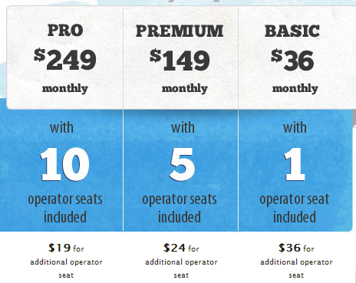
Annual Conference & Tradeshow
Celebrating 26 years of service to the Collegiate Travel Marketplace
Live Chat
Increase customer loyalty
Increase your customer support
Ability to capture clients and prospects
Two of the products out there:
http://www.livechatinc.com/
http://www.liveperson.com/

Slide 38
Annual Conference & Tradeshow
Celebrating 26 years of service to the Collegiate Travel Marketplace

Slide 39
Annual Conference & Tradeshow
Celebrating 26 years of service to the Collegiate Travel Marketplace

Slide 40
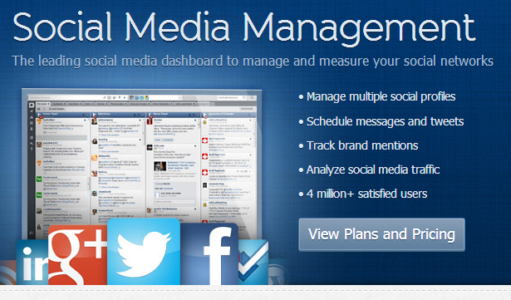
Annual Conference & Tradeshow
Celebrating 26 years of service to the Collegiate Travel Marketplace
Post to multiple social media accounts at once.
Set a time and date for your post to go live
Enable a plug-in for your browser to post news articles you may read directly to your social media account.
http://hootsuite.com/

Slide 41
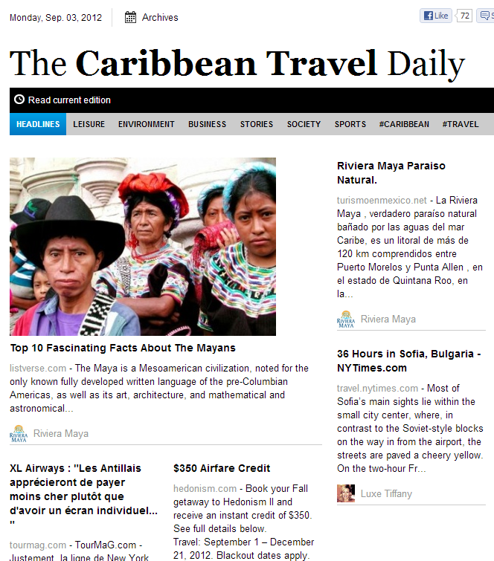
Annual Conference & Tradeshow
Celebrating 26 years of service to the Collegiate Travel Marketplace
Ability to send out daily or weekly
Add content from anywhere on the web
Include your blog articles or Twitter postings
http://paper.li/

Slide 42
Annual Conference & Tradeshow
Celebrating 26 years of service to the Collegiate Travel Marketplace
Topics You Should Post About

Slide 43
Annual Conference & Tradeshow
Celebrating 26 years of service to the Collegiate Travel Marketplace
Number of days for reimbursement when the students/staff go through your office vs. another method.
The amount or percent of money not reimbursed because the customer did not follow the policy.
Promote how someone can contact you if they need help.
How long does it take your office to resolve an issue?
Use social media to help you achieve a goal
Announce your goal and create a quarterly public report showing how close you are to your goal.

Slide 44
Annual Conference & Tradeshow
Celebrating 26 years of service to the Collegiate Travel Marketplace
Takeaways
Understand your 6 – 12 month department goals
Work with existing social media channels first, don’t reinvent the wheel, yet
Each post should add value
Social media is about communicating not marketing

